Slide 1


Please:
Sit in groups of 3-4 if you can
Open the slides and the code files of basic R

Slide 2

If you have some familiarity with coding, please

Slide 3

Basic Operation of R studio
Before we start….
Run codes together
Three tasks for you to practice
Stop me whenever you have questions
Facilitator: Sutong
Notes:
Spend explain each function as we go along
Feel free to stand , stay seated

Slide 4
1. Good Habits
Shortcuts
1. Add comments
2. Build your R studio interface
Tools → global option → Pane layout/appearance
3. Set working directory
Session → set working directory → choose directory
4. Install and prepare packages
1. run: ctrl + shift
2. <- : alt + -
Notes:
On a sunny day, she walked through the forest, following a barely visible, winding path, which is a line that twisted and turned, painted by an artist.

Slide 5
2. 1 Play with variables
Shortcuts
1. run: ctrl + shift
2. <- : alt + -
Notice
character ‘’
c( )
na.rm = TRUE
Notes:
On a sunny day, she walked through the forest, following a barely visible, winding path, which is a line that twisted and turned, painted by an artist.

Slide 6
2.2 Create data frame
Shortcuts
1. run: ctrl + shift
2. <- : alt + -
ID | Gender | Weight_KG | Height_M
S01 | Female | 56 | 1.6
S02 | Male | 78 | 1.9
S03 | Male | 67 | 1.75
Notice
character ‘’
c( )
na.rm = TRUE
Notes:
On a sunny day, she walked through the forest, following a barely visible, winding path, which is a line that twisted and turned, painted by an artist.

Slide 7
Task 1: dataframe
Shortcuts
1. Create a data frame like this, name it ‘task_1’
1. run: ctrl + shift
2. <- : alt + -
Subject | Familiarity_scale5 | Accuracy | ReactionTime_ms
S01 | 3 | 1 | 500
S02 | 2 | 0 | 200
S03 | 5 | 0 | NA
Notice
2. Change the name of column 2 to Familiarity
3. Change the name of column 4 to RT
4. Add a new column log_RT showing the logarithm of RT
package?
c( )
na.rm = TRUE
Notes:
On a sunny day, she walked through the forest, following a barely visible, winding path, which is a line that twisted and turned, painted by an artist.

Slide 8
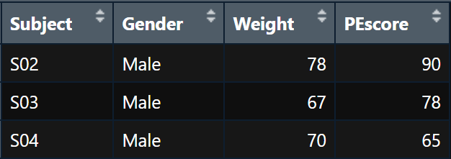
3. Play with dataset
Shortcuts
Wide Format
1. run: ctrl + shift
2. <- : alt + -
Notice
c( )
is.na()
==
complete.cases()
which()
Notes:
On a sunny day, she walked through the forest, following a barely visible, winding path, which is a line that twisted and turned, painted by an artist.

Slide 9
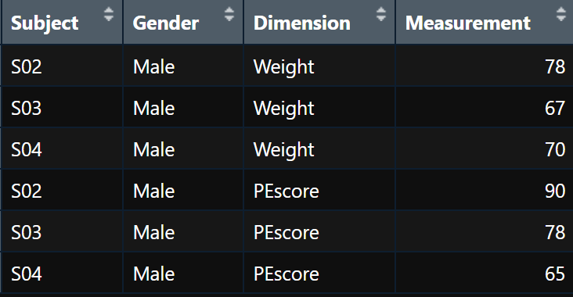
3. Play with dataset
Shortcuts
Long Format
1. run: ctrl + shift
2. <- : alt + -
Notice
c( )
is.na()
==
Notes:
On a sunny day, she walked through the forest, following a barely visible, winding path, which is a line that twisted and turned, painted by an artist.

Slide 10
Task 2: customize your dataset
Shortcuts
Read ‘psych_data’
Remove columns related to Task 2, age
Only keep accurate Task 1 data
Delete the rows with NA
Transfer this data to long format
Reorder the column:
subject-gender-wellbeing-score-RT
1. run: ctrl + shift
2. <- : alt + -
Notice
package?
c( )
na.rm = TRUE
Notes:
On a sunny day, she walked through the forest, following a barely visible, winding path, which is a line that twisted and turned, painted by an artist.

Slide 11
4. Advanced data transformation
Shortcuts
Notice
1. run: ctrl + shift
2. <- : alt + -
c( )
is.na()
complete.cases()
which()
%>%
group_by()
Notes:
On a sunny day, she walked through the forest, following a barely visible, winding path, which is a line that twisted and turned, painted by an artist.

Slide 12
Task 3: write your code in a clean way
Shortcuts
Read ‘psych_data’
Only keep accurate Task 1 data and Anxiety_Score >15
3. Calculate the mean reaction time (RT) separately for each gender in Task 1 and Task 2
1. run: ctrl + shift
2. <- : alt + -
Notice
package?
c( )
na.rm = TRUE
Notes:
On a sunny day, she walked through the forest, following a barely visible, winding path, which is a line that twisted and turned, painted by an artist.

Slide 13

Congratulations!
Facilitator: Sutong

